Slide 1
Kenya Meteorological Society
David Gikungu
GM3-IFMS (13/09/2013)

Slide 2

Overview
Mission and Vision
Objectives
Activities
Structure of KMS
Membership

Slide 3
Kenya Meteorological Society
Who we are
KMS is a professional Society registered in 1987 with the objective of promoting the understanding and applications of the science of meteorology and related sciences for sustainable socio-economic development.
Vision
A leading professional society promoting the understanding
and application of weather and climate science for the well-
being of humanity.

Slide 4
Kenya Meteorological Society
Mission
To advance meteorological and related sciences and their
applications, in weather and climate related sectors for
sustainable development.
Our clients
Our clients are our members, students, research
institution, donors, partners, universities, colleges and
the general public

Slide 5
Core Functions
Facilitate communication of discoveries and innovations that contributes towards advancement of meteorological knowledge
Collect, analyze and publish information which contributes to the promotion of meteorological knowledge
Promote research in meteorological science
Collaborate with other professional organizations and institutions, for effective and efficient exchange of knowledge
Promote professional standards within the practice and application of meteorology and related sciences in Kenya

Slide 6
Activities
Publications (Journal and Bulletin)
Conferences and Workshops
Expos
Lectures and Seminars
Meteorology Student Awards
Mentorship
Social responsibility

Slide 7
Ongoing activities
Preparations for the 11th KMS international conference
Preparations for the 2nd Save the Earth Expo
KMS Journal volume 7
Call for research
Development of 2014-2018 strategic plan
School outreach programme
Code of Ethics and Conduct guide
Preparations for Annual Dinner

Slide 8
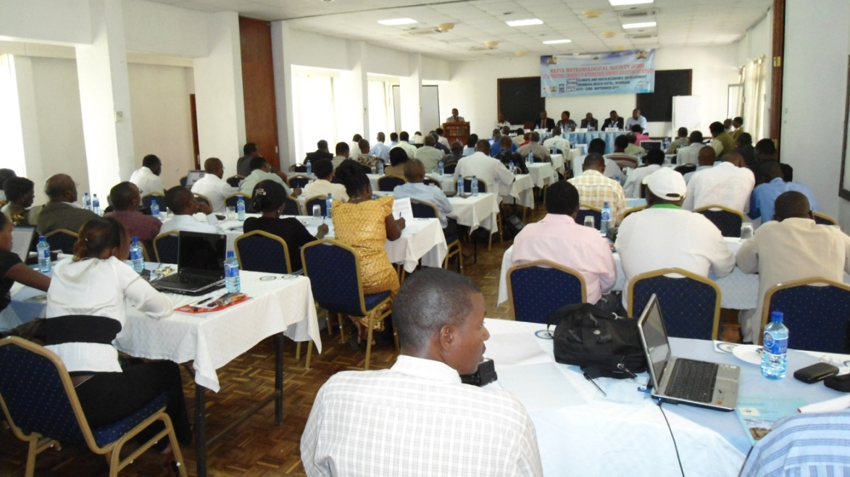
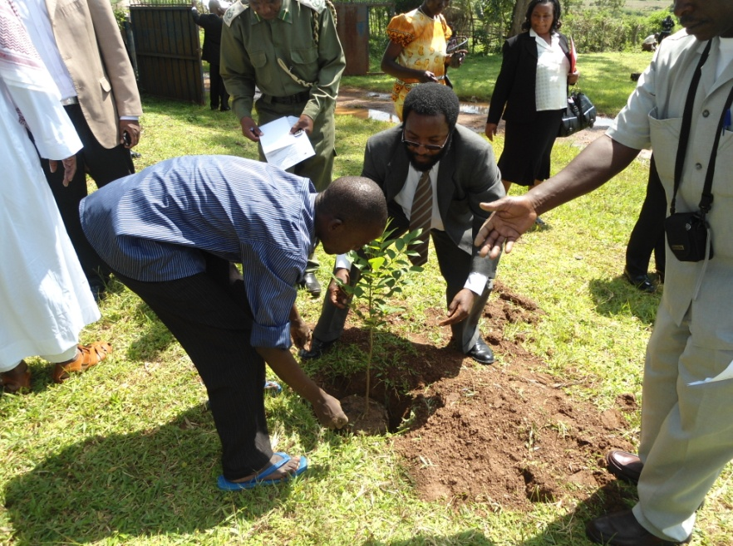
A Conference
session in
September 2011
Tree planting during
the National
Workshop in
western Kenya in
September 2012

Slide 9
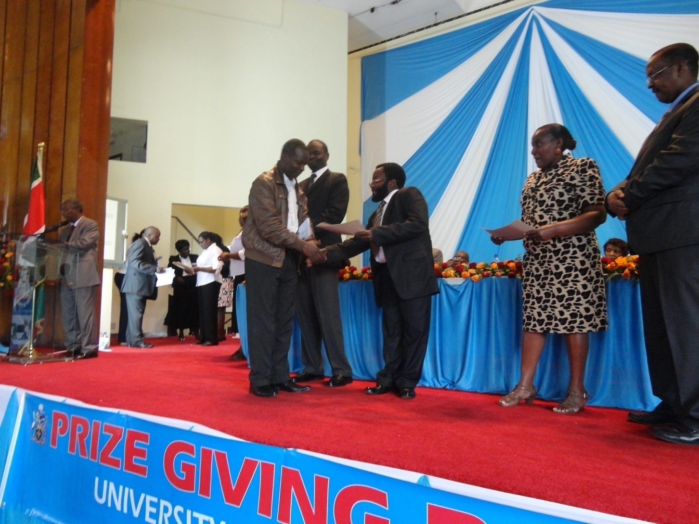
Student Awards

Slide 10
Structure of KMS
Trustees
Executive Committee
Advisory Board
Management Committee
Executive
Officer
Publications
Committee
Conference
Committee
Professional
Accreditation
R & D
Committee
Procurement
Committee

Slide 11
Membership
Ordinary Members
Life Members
Honorary Members
Fellows
Corporate Members
Student Members
Associate Members

Slide 12
The End
Thank you

