Slide 1

The Philippine Meteorological Society
Esperanza O. Cayanan
President
The Third Global Meeting (GM3) of the
International Forum of Meteorological Societies (IFMS)
12 to 13 September 2013
Reading, UK

Slide 2

OUTLINE
PMS in a Nutshell
Activities
Challenges
Way Forward

Slide 3
PMS in a Nutshell
Is a non-stock, non-profit organization which aims to promote meteorology as a science and a profession
Established in 1952 by weather forecasters of the Philippine Weather Bureau
Managed by nine (9) member Board of Trustees
With current membership of 279

Slide 4

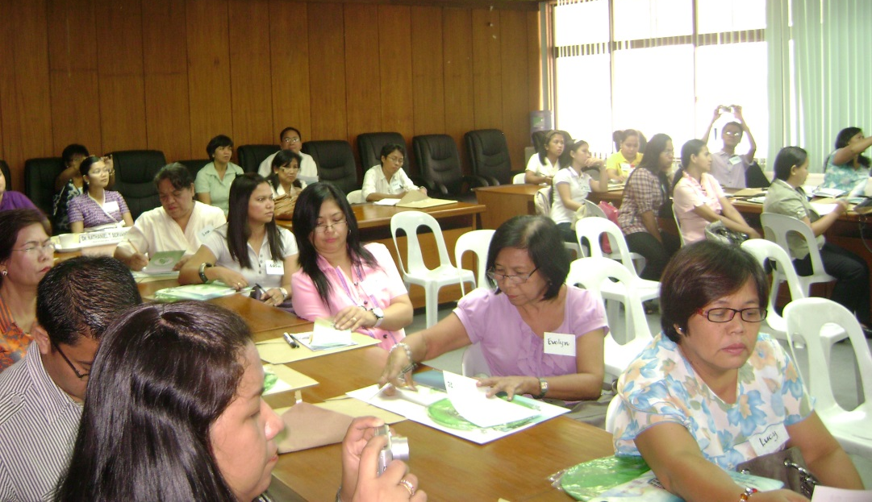
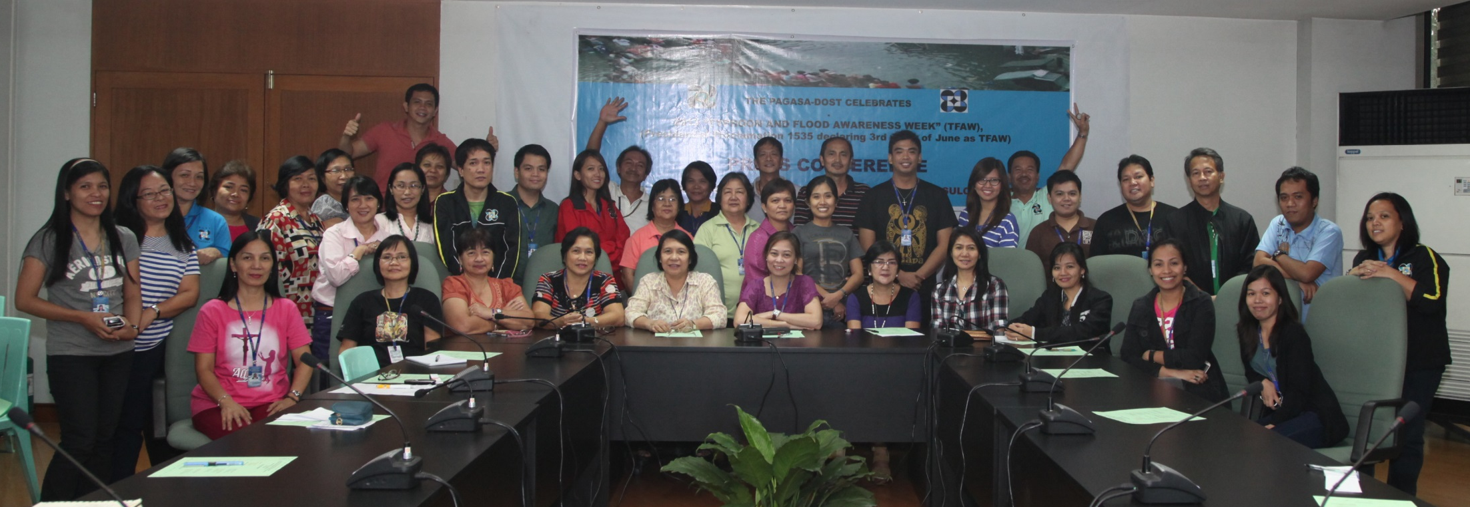
Highlights of Activities: 2012- 2013
Conduct of Seminars/workshops
Seminar/workshop for science teachers entitled “Understanding Weather, Floods and Climate Change” on June 22, 2012 as part of the celebration of the National Typhoon and Flood Awareness Week
Seminar for NMHS administrative & technical support staff on new “Rainfall Warning System in the Philippines” on June 21, 2013 as part of the celebration of the National Typhoon and Flood Awareness Week

Slide 5

Highlights of Activities: 2012 - 2013
Conducted in cooperation w/ PAGASA the Technical Symposium during the celebration of the 2013 World and National Meteorological Day on March 21, 2013.
Conducted the PMS Slogan Writing Contest
“ Promoting the science of meteorology…
towards a weather-informed, safe and progressive country”

Slide 6
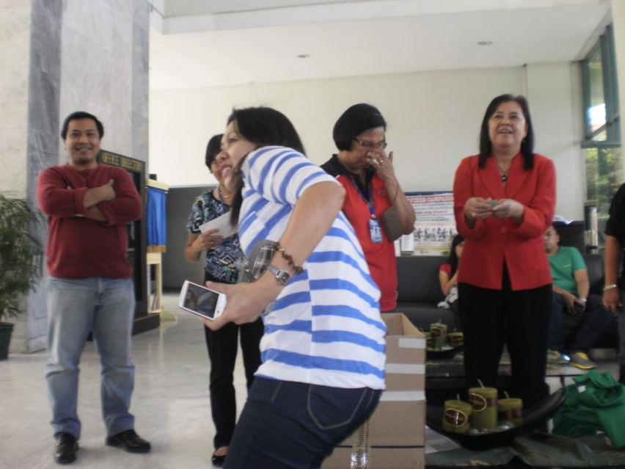
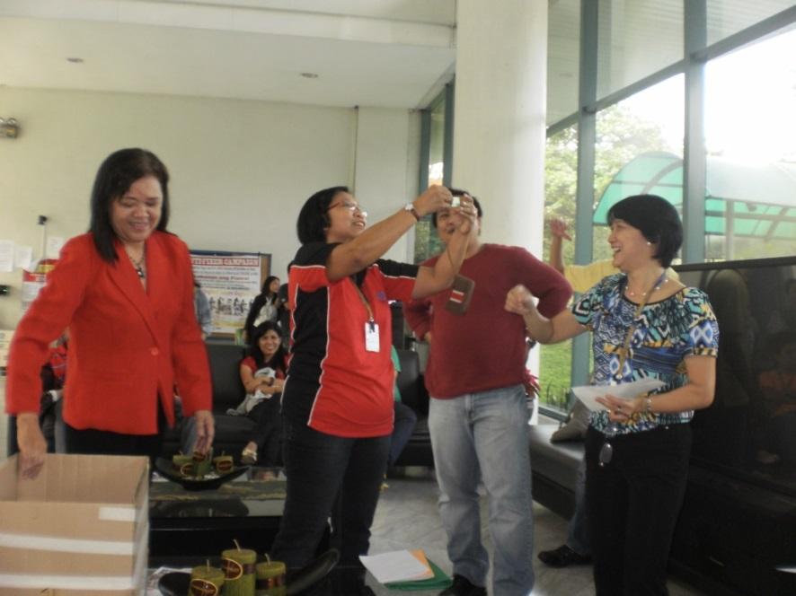
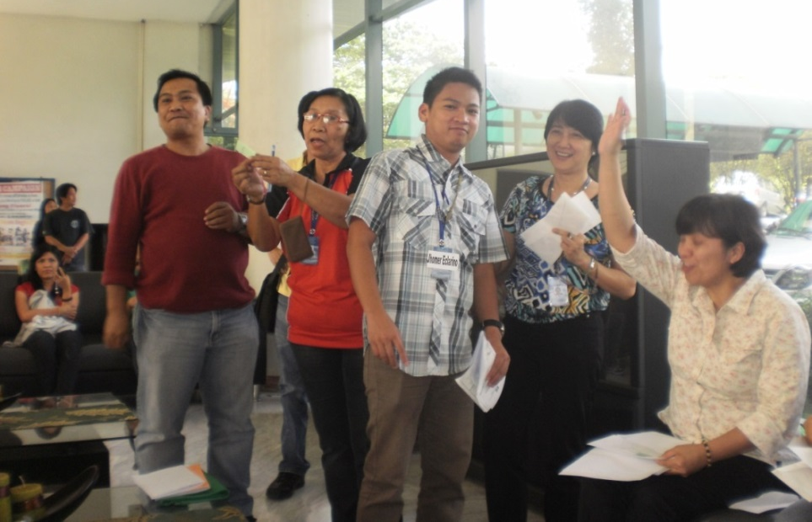
Highlights of Activities: 2012-2013
Fund raising for typhoon & flood victims
PMS Raffle Draw on Jan 18, 2013

Slide 7
Highlights of Activities: 2012- 2013
Collaboration with national and international institutions:
Assisted Japan Agency for Marine-Atmosphere Sci. & Tech. (JAMSTEC) in the conduct of Vietnam-Philippines Experiment (Dec 22-30, 2012) and Summer Monsoon Expt. (May-Aug. 2013)
Partnership w/ private agencies and Phil. Met Service i.e., National Grid Corp. of the Philippines (NGCP), we provide real-time data for “Storm Tracking Alert and Relay System” (STARS) and certifications of storms/lightning occurrences. PMS charge admin fee to private corporations and give honoraria for extra work of the members.

Slide 8
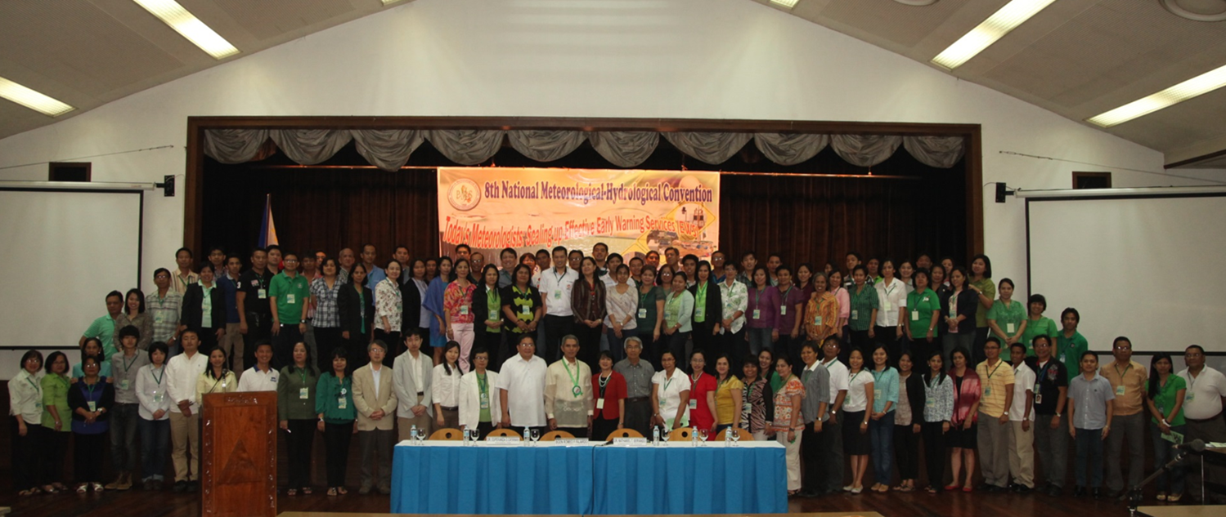
Highlights of Activities: 2012 - 2013
Conduct of the 8th National Meteorological Hydrological Convention, 21-22 Feb 2013

Slide 9
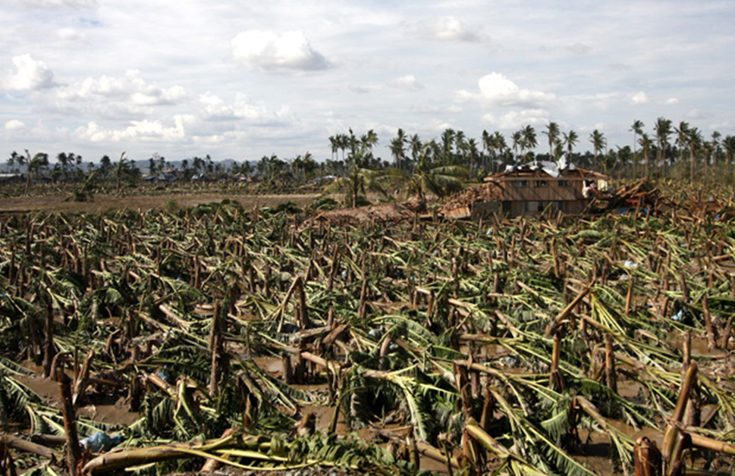
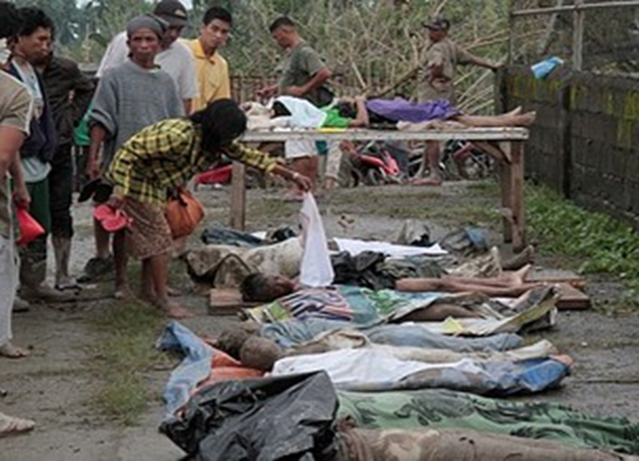
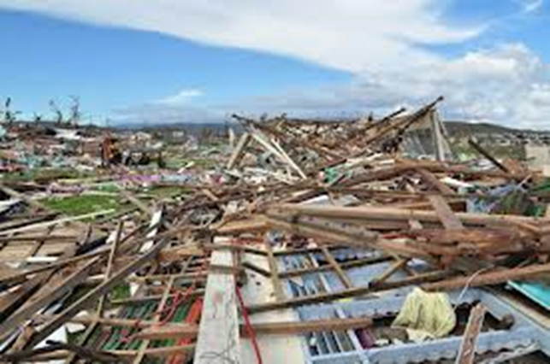

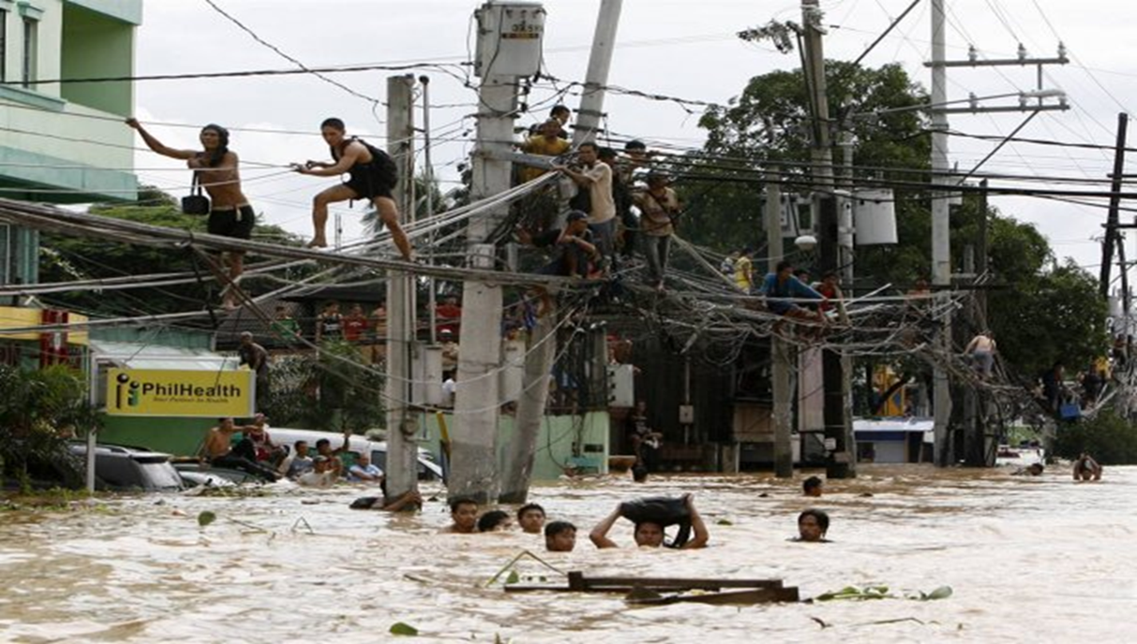
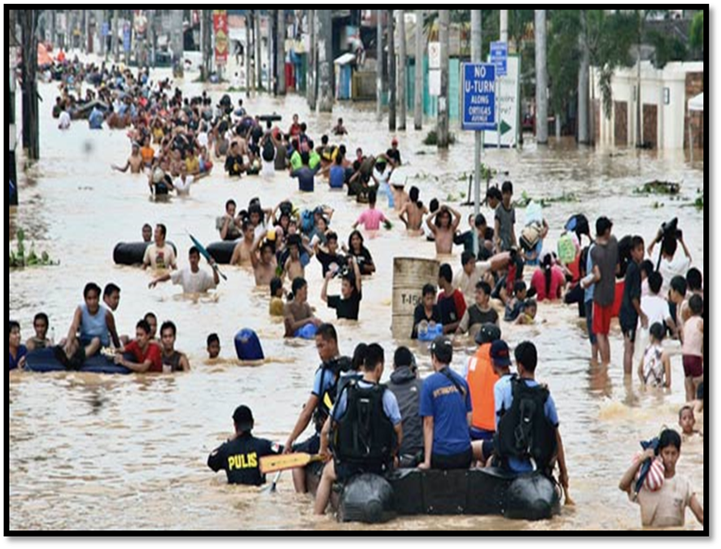
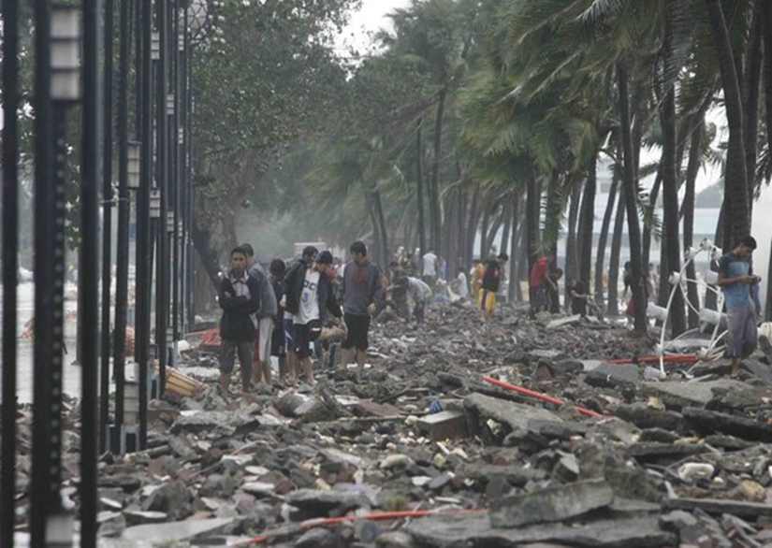
Theme: "Today's Meteorologists: Scaling up Effective Early Warning Services"
SUB-THEMES
Early warning systems in the Philippines – include indigenous equipment to advanced warning systems
How to improve EWS from Lessons learned on extreme weather events
Meteorologists of today and their expanding role in development of early warning systems
Recent Developments in hydrometeorology and related fields

Slide 10
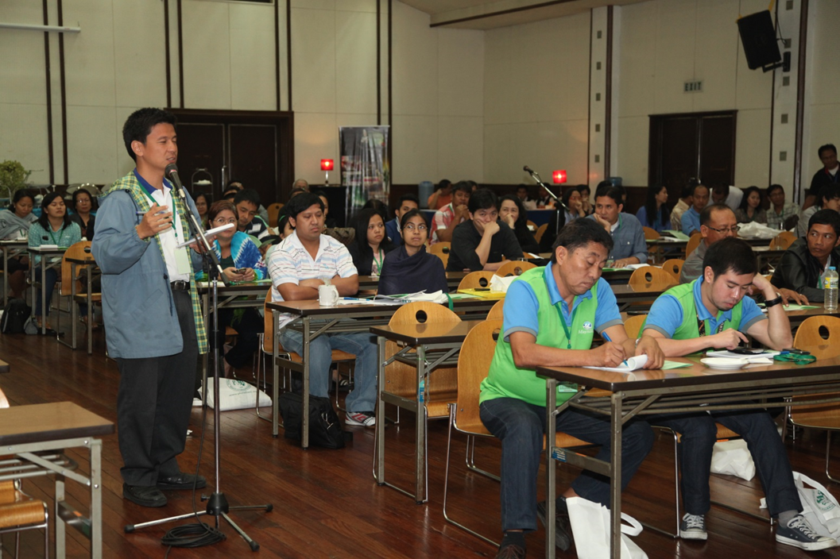
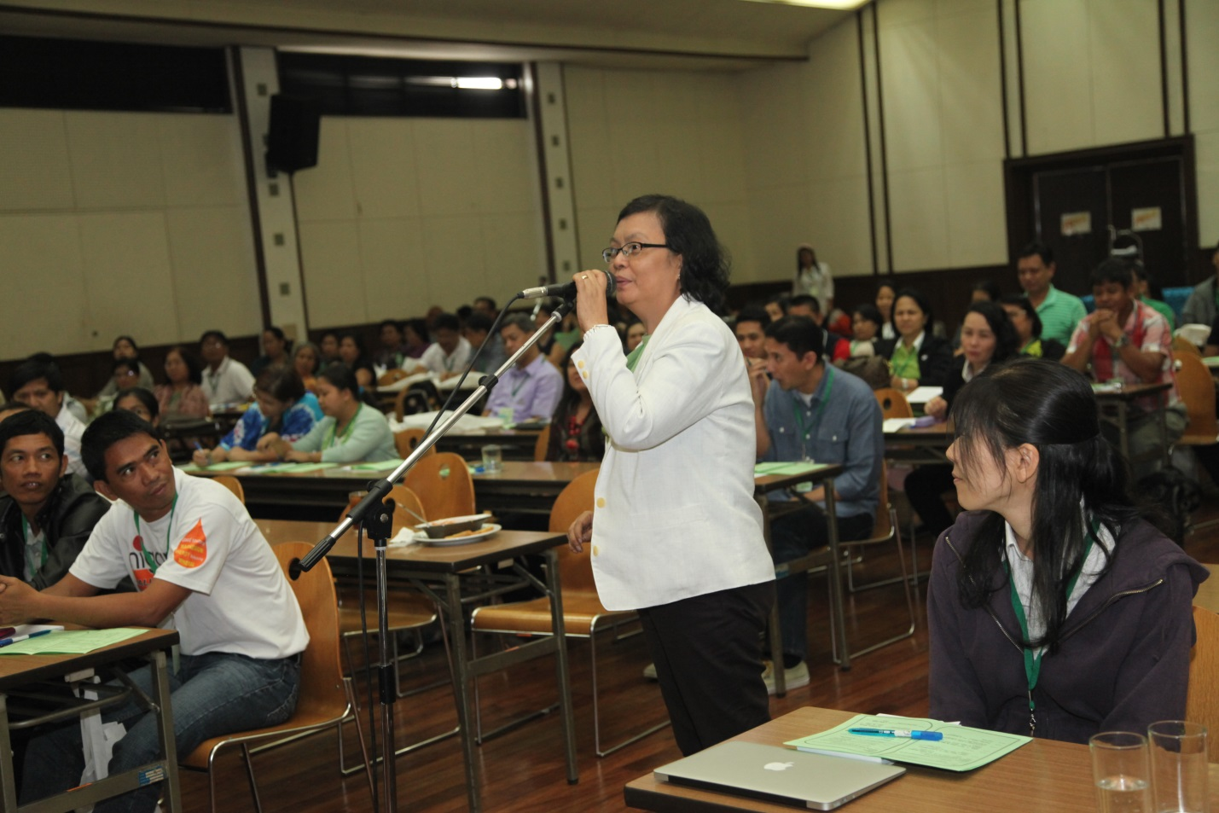
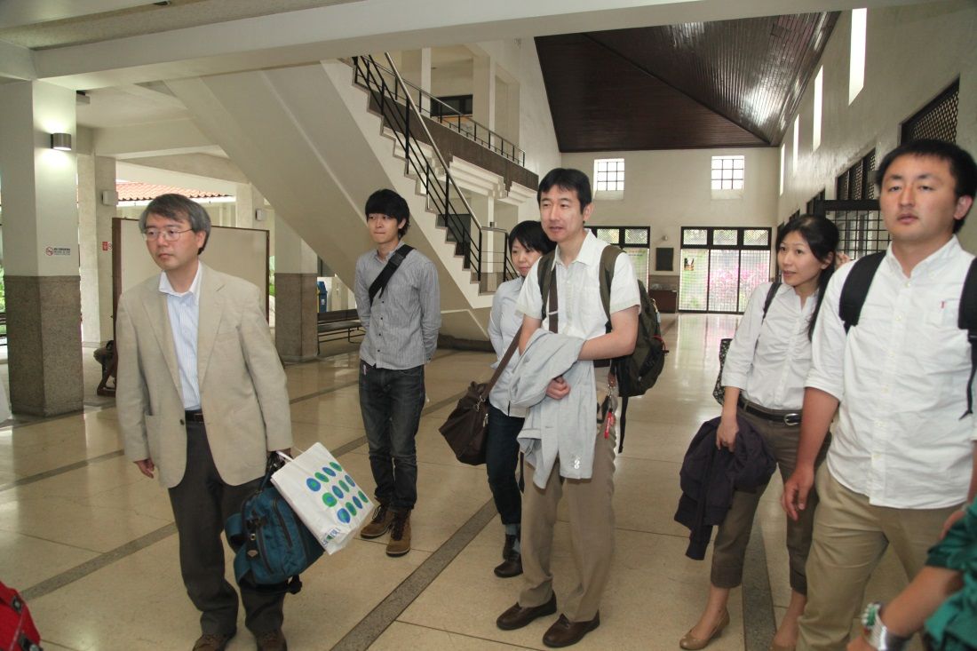
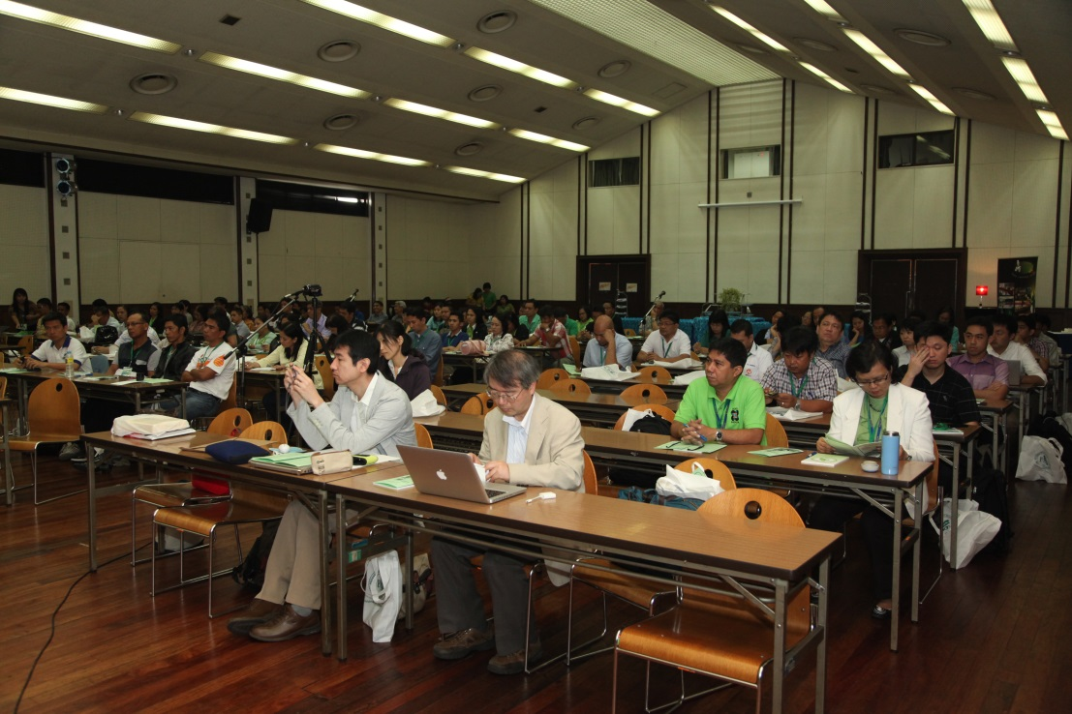
Open Forum
Foreign guest lecturers

Slide 11
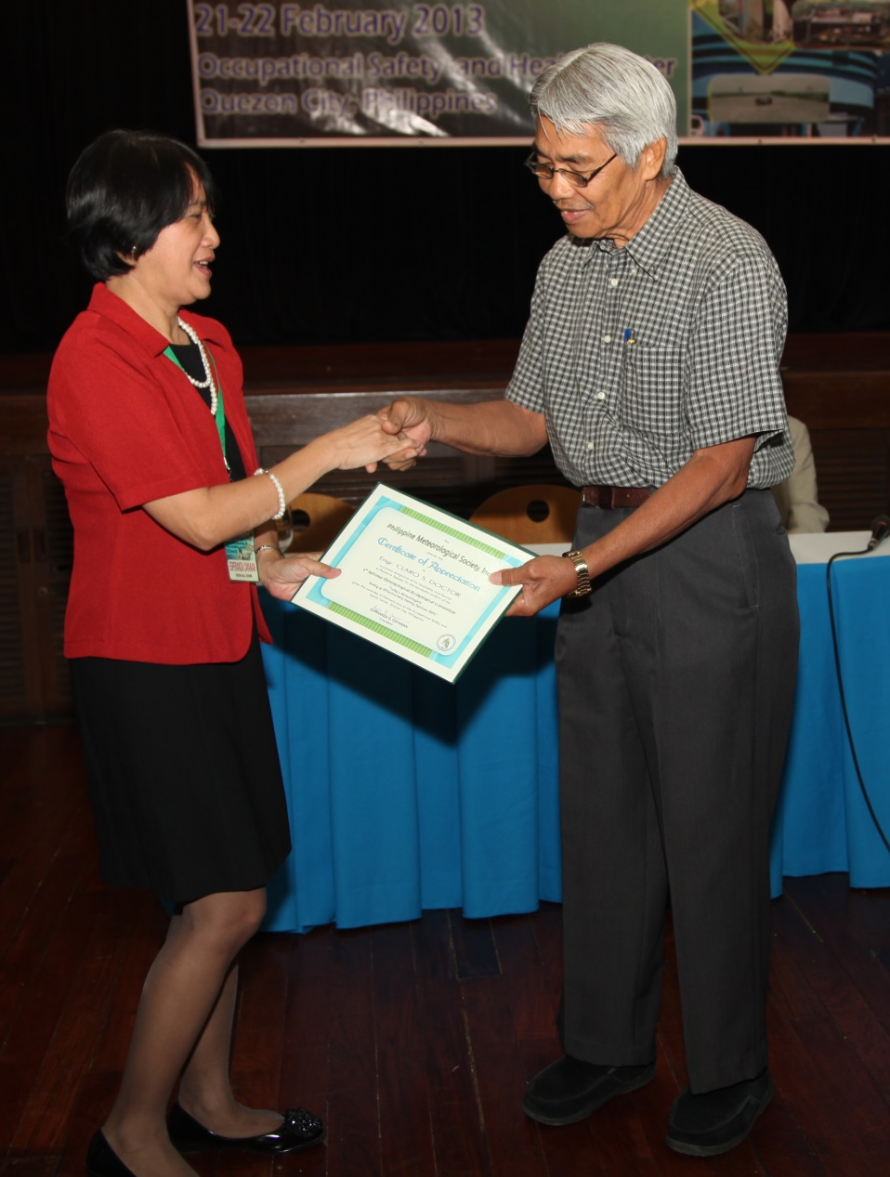
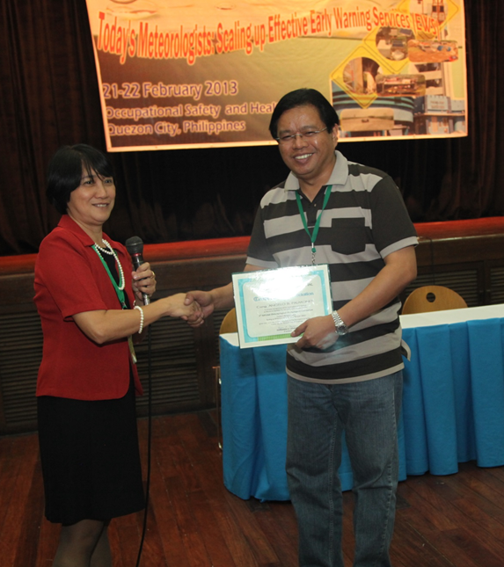
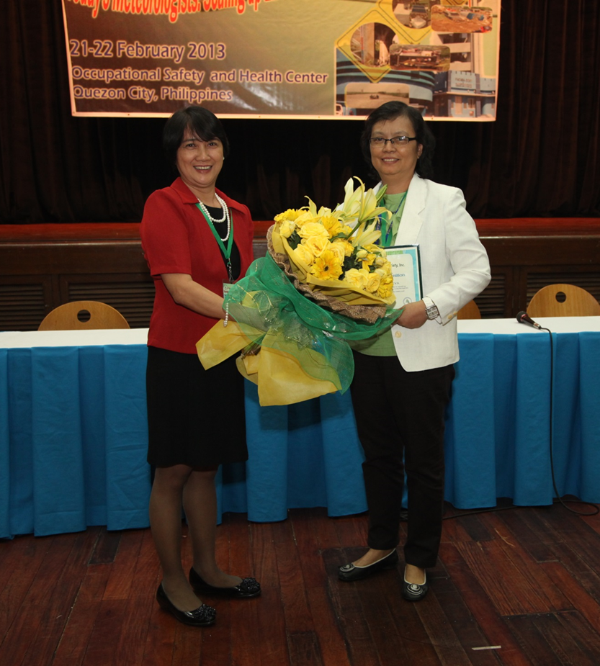
Awarding of certificates of appreciation to special persons w/ significant contribution for the promotion of Meteorology in the Phils.
Cong. Angelo Palmones – bill on B.S. Meteorology in Philippines
Mr. Claro Doctor – pioneer Board of Director, one of the founders of PMS
Dr. Susan Espinueva – excellent leadership as PMS President for 3 terms

Slide 12

CHALLENGES
Preserve/keep up the dignity/integrity and boost the morale of Filipino Meteorologists
Promote awareness and education campaign on the changing extreme weather events
PMS Publication

Slide 13
WAY FORWARD
Conduct of international Meteorological Hydrological Convention
Update/upgrade of the PMS Website
Enhance collaboration and linkages with other national and international institutions/organization
- NGCP STAR project, Greenpeace research project
- JAMSTEC projects: Lightning observations, AWS Stns. in Daet & Laoag
- Philippine Climate Change Commission on Twin Phoenix Project

Slide 14
THE PHILIPPINE METEOROLOGICAL SOCIETY, INC. (PMS)
Mabuhay!

