Slide 1
American Meteorological Society
Disaster Prevention, Mitigation, and Adaptation
Second Global Meeting of the International Forum of Meteorological Societies
Mr. John E. Jones, Jr.
(johnejonesjr@jejonesconsulting.com)
Deputy Director, US National Weather Service (Retired)
November 3, 2011

Slide 2
The American Meteorological Society (AMS) promotes the development and dissemination of information and education on the atmospheric and related oceanic and hydrologic sciences and the advancement of their professional applications.

Slide 3
AMS is an organization that supports its 14,000 members, the science, and the world’s population to better understand how the interaction between earth, land, and sea can impact any person in the world.
Through AMS sponsored conferences and meetings, colleagues from around the world share research, new technology, and forecasting techniques. Information is shared that can be used to better understand and forecast phenomenon that cause disasters.
Ideas on how to better communicate disaster information is also exchanged.

Slide 4
AMS represents all 3 parts of the scientific community – academic, private, and public. A large part of the private sector is broadcast meteorologists.
Each year the Broadcast Conference is devoted to how broadcasters can improve their efforts to better prepare the populations in their communities for potential disasters (and not just weather disasters, but also things like earthquakes, which typically fall to the broadcast met), and also how they can improve their reach and effectiveness when a disaster is unfolding in terms of warnings and safety advice. Broadcast meteorologists are thought of as the "Station Scientist."

Slide 5
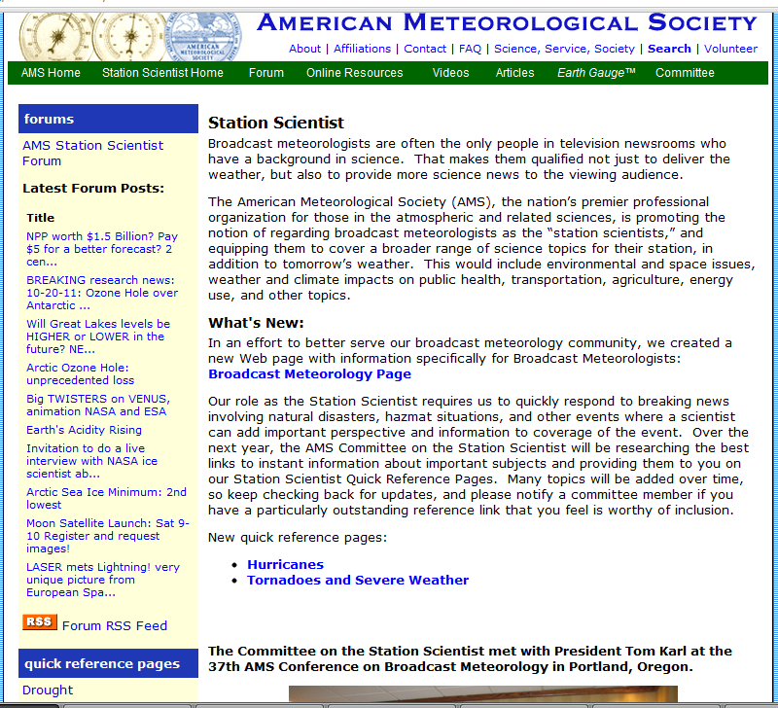

Slide 6
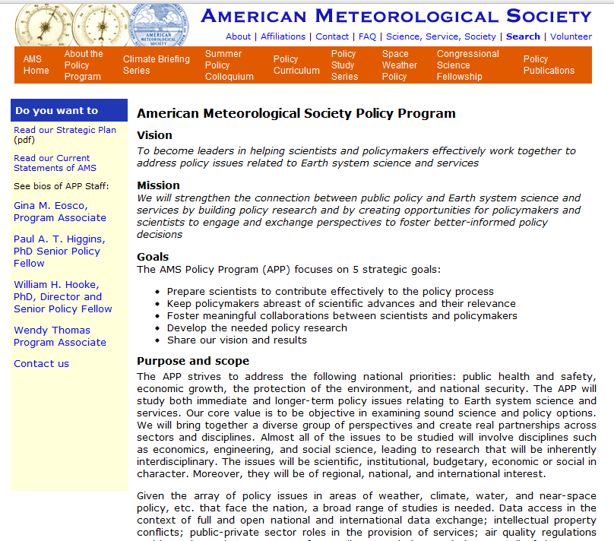

Slide 7
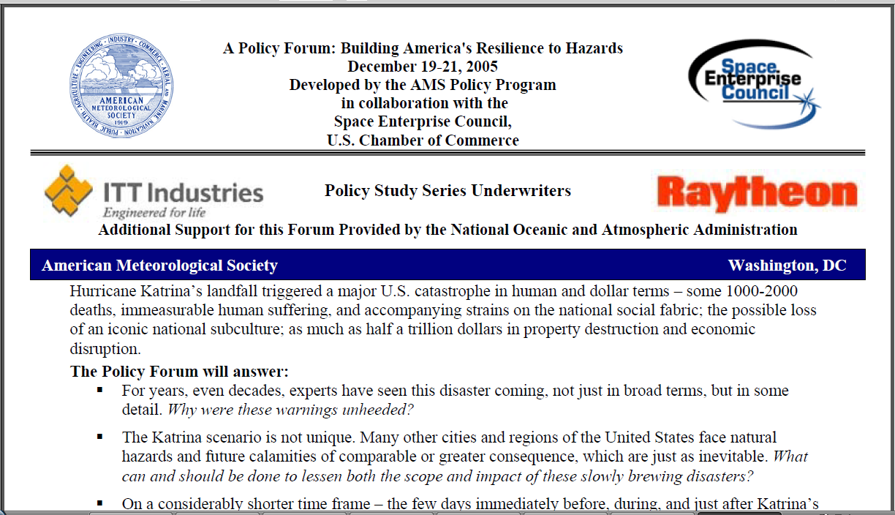
landfall – decision makers and policy officials operated in an information deficit. What actions are

Slide 8
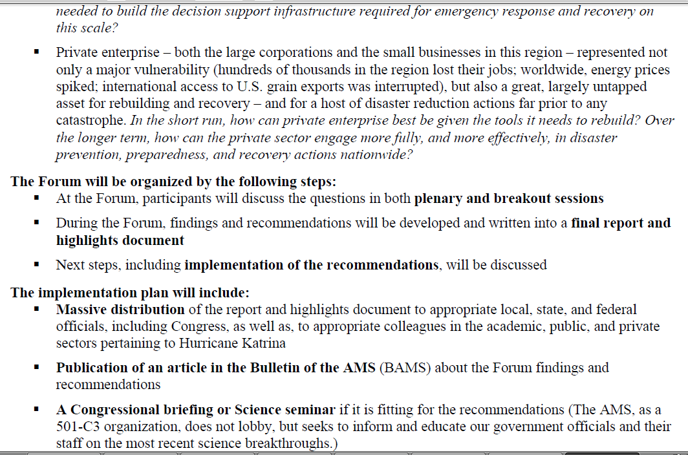

Slide 9
AMS Journals (12)
Bulletin of the American Meteorological Society
Current Issue Volume 92, Issue 9 (September 2011)
Weather, Climate, and Society
Current Issue Volume 3, Issue 2 (April 2011)
Journal of the Atmospheric Sciences
Current Issue Volume 68, Issue 10 (October 2011)
Journal of Applied Meteorology and Climatology
Current Issue Volume 50, Issue 10 (October 2011)
Journal of Physical Oceanography
Current Issue Volume 41, Issue 9 (September 2011)
Monthly Weather Review
Current Issue Volume 139, Issue 10 (October 2011)
Journal of Atmospheric and Oceanic Technology
Current Issue Volume 28, Issue 9 (September 2011)
Weather and Forecasting
Current Issue Volume 26, Issue 5 (October 2011)
Journal of Climate
Current Issue Volume 24, Issue 19 (October 2011)
Journal of Hydrometeorology
Current Issue Volume 12, Issue 5 (October 2011)
Meteorological Monographs
Current Issue
Earth Interactions
Current Issue Volume 15, Issue 30 (October 2011)

Slide 10
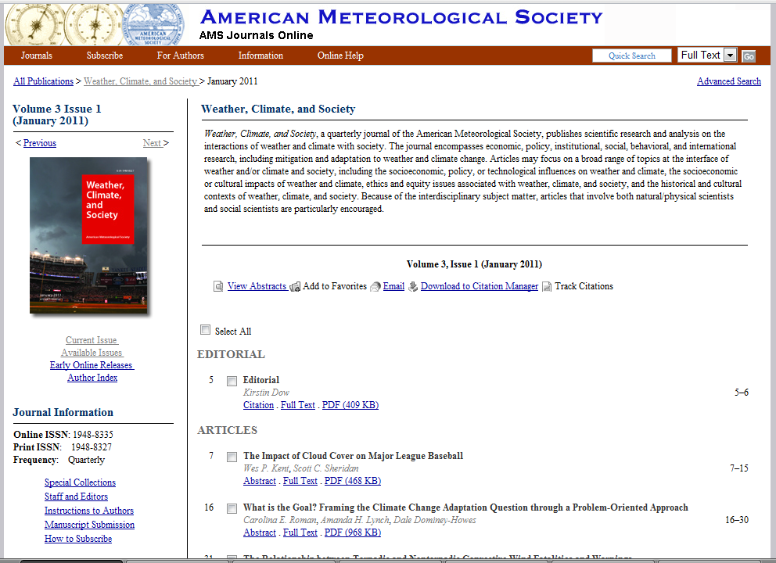

Slide 11
Thank You

