Slide 1
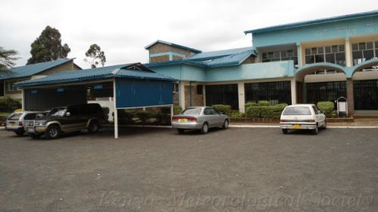
Towards up-scaling the activities of the Kenya Meteorological Society

Slide 2
BRIEF HISTORY OF KMS
The Kenya Meteorological Society (KMS) was registered in 1989, as a non-profit making professional/scientific society in a bid to promote the understanding of meteorology
Mission
To advance meteorological and related sciences and their applications, in weather and climate related sciencies for sustainable development.

Slide 3
2. Opportunities for KMS
  Research and consultancy
  Dissemination and communication of
  research results
  Preservation of research results
  Continuous professional development

Slide 4
3. Operational structure and function
Close collaboration with National Met. Service and
Universities
Operational budget largely funded by Kenya Government
Operational activities through committees
More linkages with industry desired

Slide 5
4. Committees
Executive committee
Management committee
Workshop organizing committee
Journal committee
Bulletin committee
Accreditation committee

Slide 6
5. Impacts of KMS activities
At least a workshop every year:
International or local
  This year’s international conference brought together 97 participants from many sectors
Many sponsors participated
At least two journal vomes a year
At least two newsletters a year
KMS accredited to and a member of Association of
professional Societies in East Africa (APSEA)

Slide 7
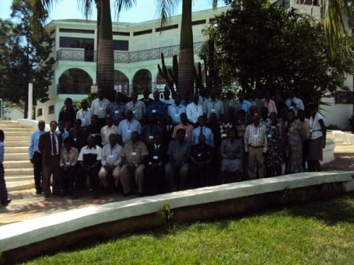

Slide 8
6. Impacts of membership of KMS in APSEA
  Improved recognition of KMS by other
  professional societies in Kenya
  National issues within the mandate of the
  society articulated by the society
  Initiation of Code of Conduct for members

Slide 9
7. Research and Development committee
  Facilitates funding for practical support of
  young members and young Scientists
  Mentorship programme through research
  activities

Slide 10
8. Linkages and collaborations
Promising areas :
Climate change Science: Attribution and Adaptation
Promotion of science of Meteorology,
Millennium Development Goals

Slide 11
9. Preservation of Scientific knowledge
  Journal increasingly reaching more readership
  Need for a broad range of editorial board members for enhanced quality and regional reach
  Availability of articles online makes dissemination quite efficient

Slide 12
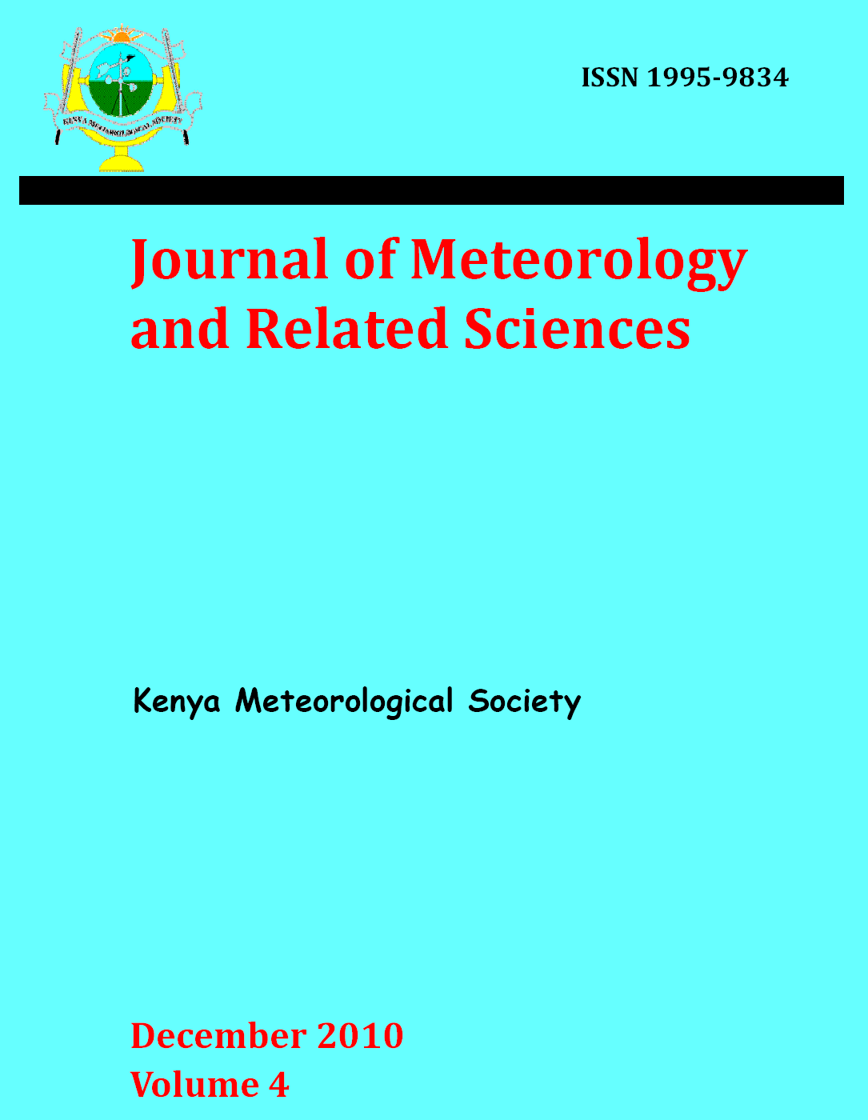

Slide 13
10. Code of conduct for members
To attain a level of acceptance by other societies we were required to formulate Codes of Conduct
This code is intended
  to set out standards of conduct and
ethical behavior for members and staff of the KMS through its mission and its core values
In pursuing the KMS mission C. of C. has issued high quality ethical standards applicable to professional of meteorology in Kenya.

Slide 14
11. Way forward
Enhance linkages and collaborations
Sound financial base
Improved visibility of the society nationally and regionally
Enhance Research and development, Dissemination and communication of results, and improve ranking of the journal

